Slide 1
SQL (Basic)
Vanessa Casillas
Graduate Fellow

Slide 2
Before we start
Download
DbeaverSqliteGUI environment
https://dbeaver.io/
Download and install Community version on local machine (installer available for Windows, Mac and Linux)
Survey
https://github.com/CMC-QCL/SQL

Slide 3
Agenda
SQL Overview
Relational Databases
Databases
Basics SQL Commands Demo
Resources
SQL Database Query Difference
Operation Order
Activity
Contact Info
Answers
Basic SQL Statements
Notes:
Edminer.

Slide 4
If you want to…
See data
Relationship between data
Find any cell
Add data to cells
To add order to information

Slide 5
SQL Overview
Structured Query Language
Crud: create, read, update, delete
Create databases and tables
Look at specific data
Make changes to data and remove data
And more (level 2)
Notes:
SQL is acronym for Structured Query Language
Language specifically designed to access and work with relational databases
Relational databases are databases that store and provides access to data points that are related to one another. Relational databases are based on the relational model, an intuitive, straightforward way of representing data in tables.
Databases need a method for accessing their content, manipulating and retrieving the information
These methods called database language
SQL is the most common and widely uses language for accessing and interacting with databases
Originally developed in the 1970s at IBM
Original acronym –SEQUEL –Structured English QUEryLanguage
acronym changed to SQL because SEQUEL trademark belonged to British aircraft production company Hawker SiddeleyDynamics Engineering Limited (later part of British Aerospace, now BAE Systems)

Slide 6
Relational Databases
A collection of tables
Set of columns in each table and rows with data
Each row is called a record
Data between tables can be related between each other
Collection of tables is called schema
Notes:
We are surrounded by data
The current workshop has data about participants, their email address, what institution they are from
How do we store and organize the data?

Slide 7
Relational DBMS
Courses_Students
School_Courses
ID | ClassID | Semester
71225 | 1005 | Fall21
86634 | 1006 | Spr22
32238 | 1009 | Spr22
ClassID | Title | ClassNum
1005 | Intro to Art History | 500
1006 | Intro to SQL | 501
1009 | Intro to Datebases | 300
Students_Attendees
ID | Name | Grade | DOB
71225 | Lili | Freshman | 03/12/1995
32238 | Brenda | Senior | 05/28/1989
86634 | James | Freshman | 09/20/1999

Slide 8
The Relational Model
Primary Key
CustomerID | CustomerName | Status
1 | Instagram | Active
2 | Facebook | Active
3 | Myspace | Inactive
Row or Tuple
Rows are cardinality
Columns are degree
Table called a Relation
Column or Attribute

Slide 9
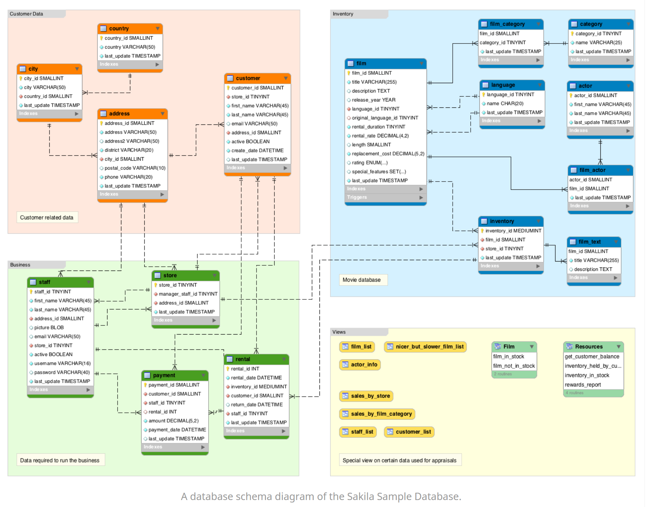
Schema Example
https://database.guide/what-is-a-database-schema/

Slide 10
Vocabulary
Data Definition Language (DDL):
CREATE, DROP, ALTER, TRUNCATE
Data Manipulation Language (DML):
INSERT, UPDATE, DELETE
Data Query Language (DQL):
SELECT, JOIN
Data Control Language (DCL):
GRANT, REVOKE

Slide 11
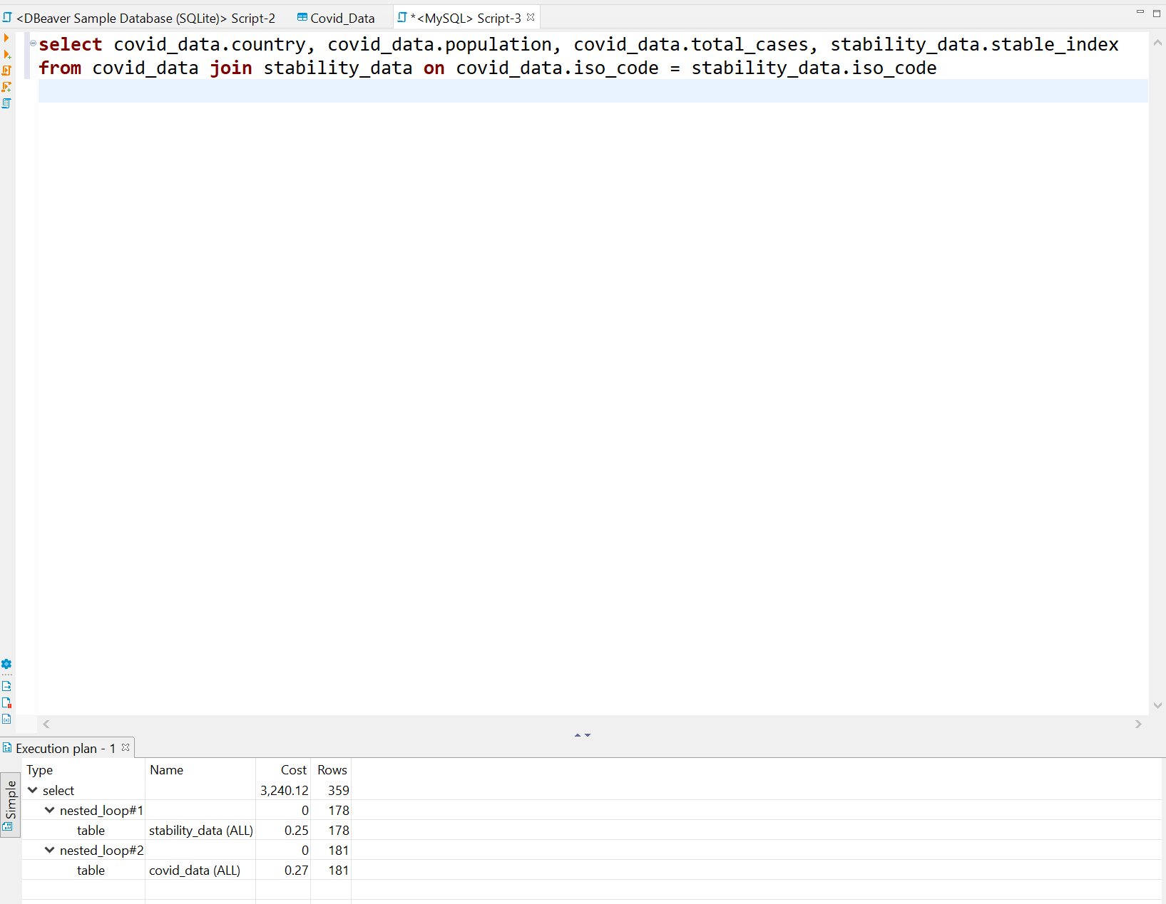
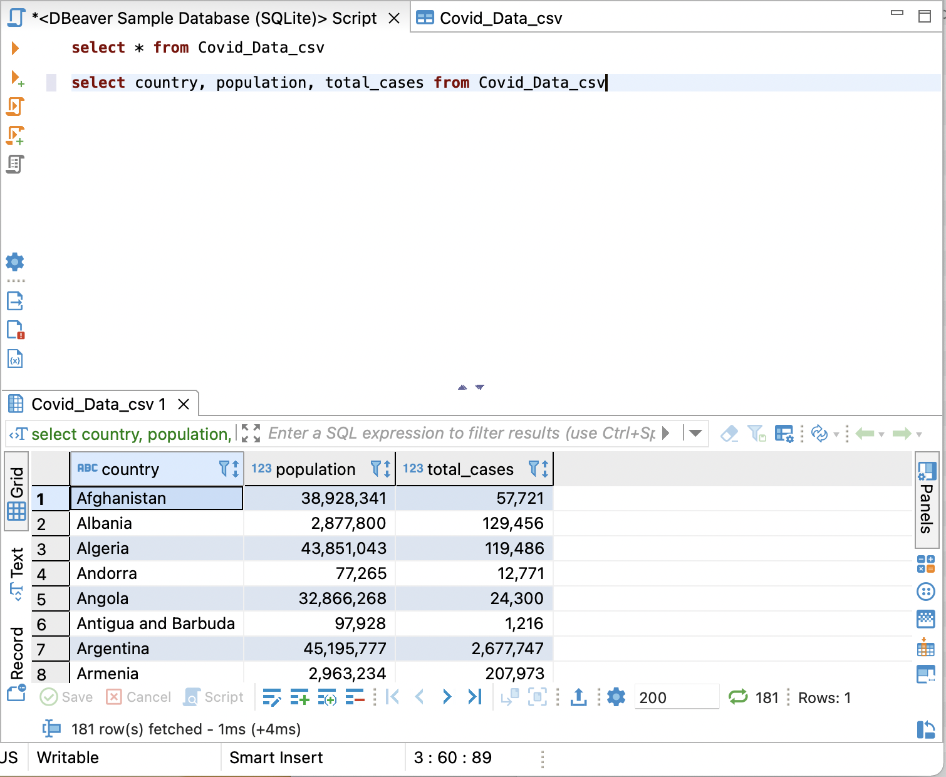
Basic SQL Statements
VIEW: virtual table
INDEX: users cannot see the index; it is used to retrieve data from the database more quickly

Slide 12
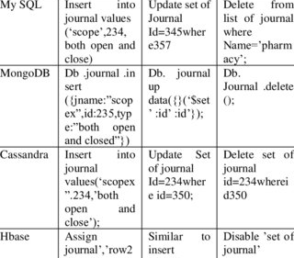
SQL Severs Syntax
Sqlite
MySql
Postgresql
Maria DB
Kumar, M. Sandeep, and Prabhu .J. “Comparison of Nosql Database and Traditional Database-an Emphatic Analysis.” JOIV : International Journal on Informatics Visualization, vol. 2, no. 2, 2018, p. 51., https://doi.org/10.30630/joiv.2.2.58.

Slide 13
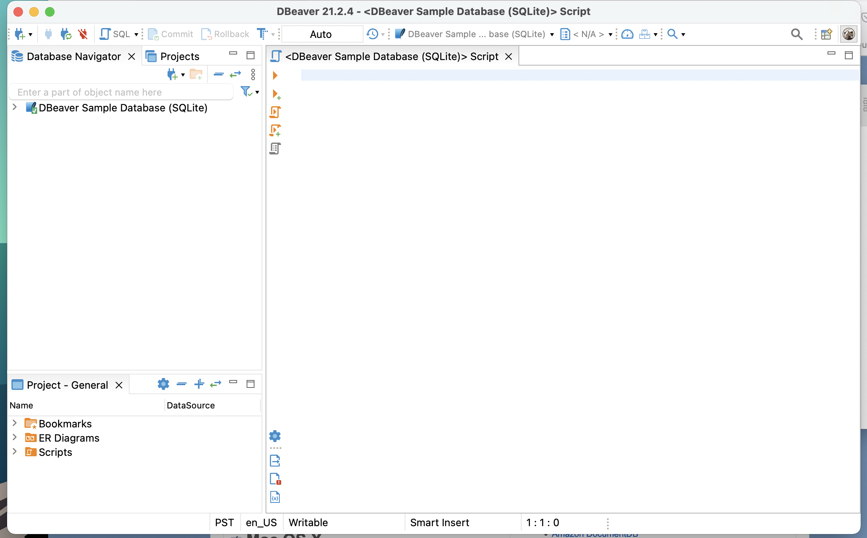
Interface

Slide 14
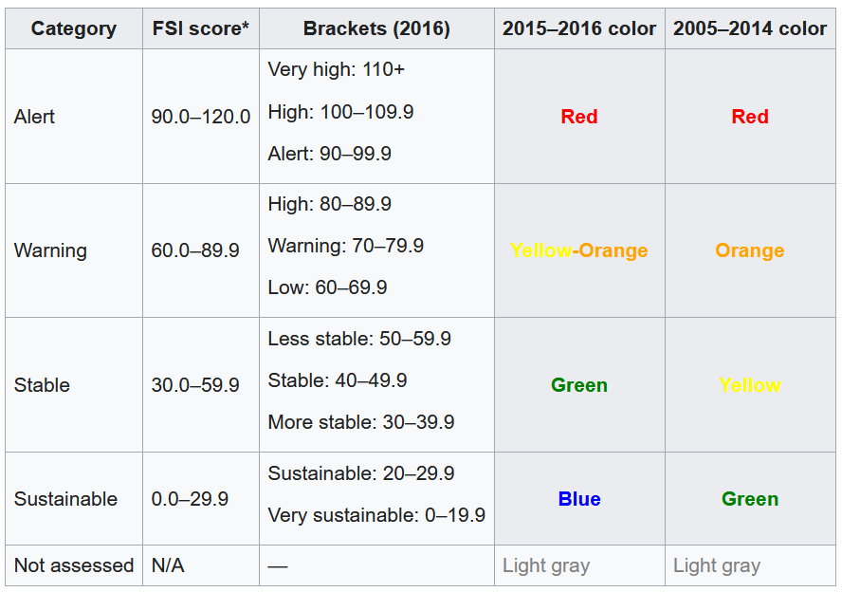
Today’s Data
Our World in Data (owid) on COVID by country and by continent
https://ourworldindata.org/
World Stability index data from Fund for Peace
https://fundforpeace.org/
https://en.wikipedia.org/wiki/Fragile_States_Index

Slide 15

Basic SQL Commands
Notes:
Make three different columns on each slide and an example (visual) in a simple matter.

Slide 16
Demo Agenda
Import a data table called Covid_Data that has Our World in Data (owid) on COVID by country and by continent
Query using the SELECT statement
Filter a query using the WHERE clause
Create data table called Stability_Data
Insert World Stability index data from Fund for Peace
Entry data is provided
Relate the two tables using the JOIN connector
Aggregate Functions

Slide 17
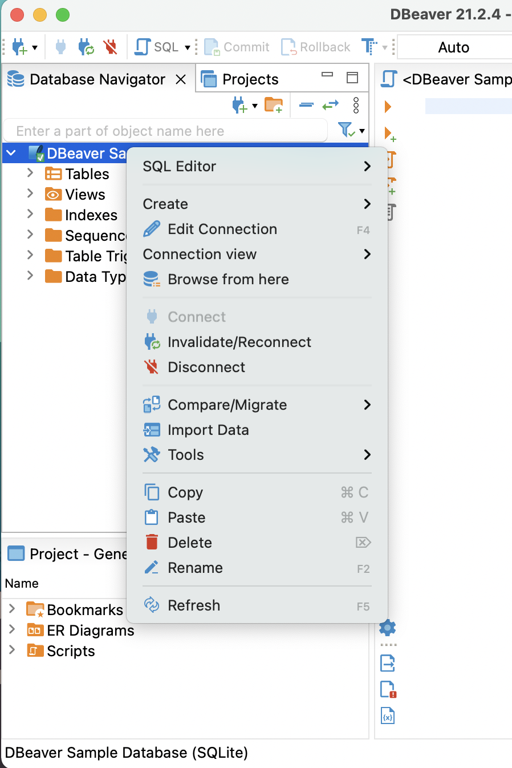
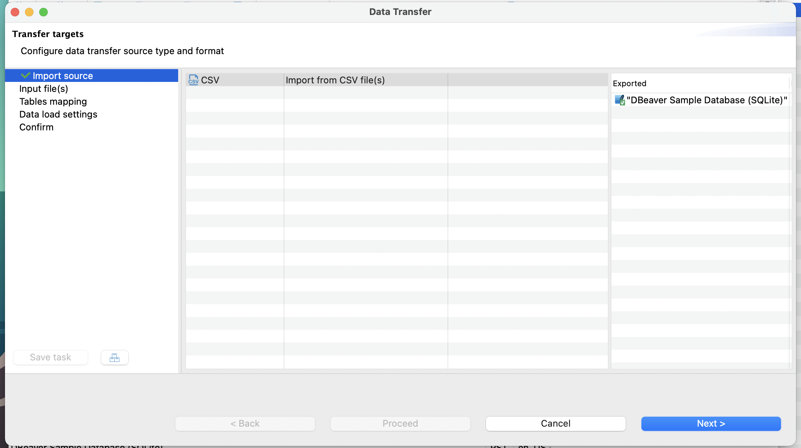
Import CSV

Slide 18
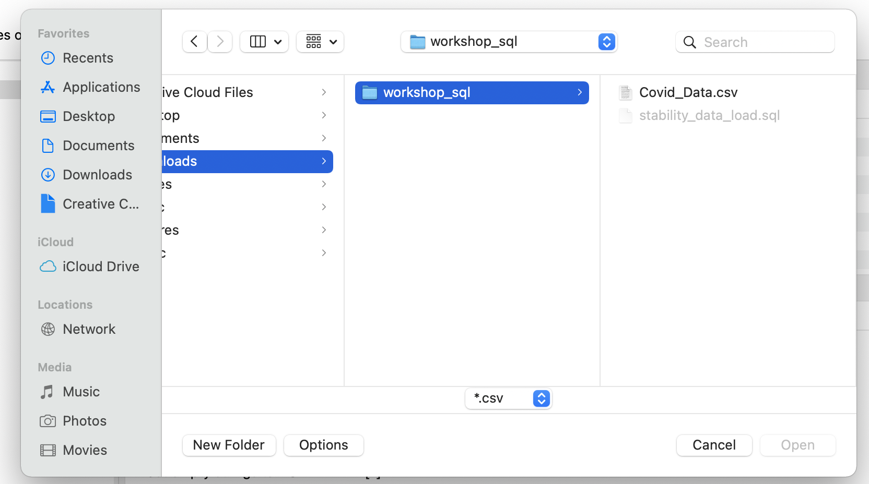
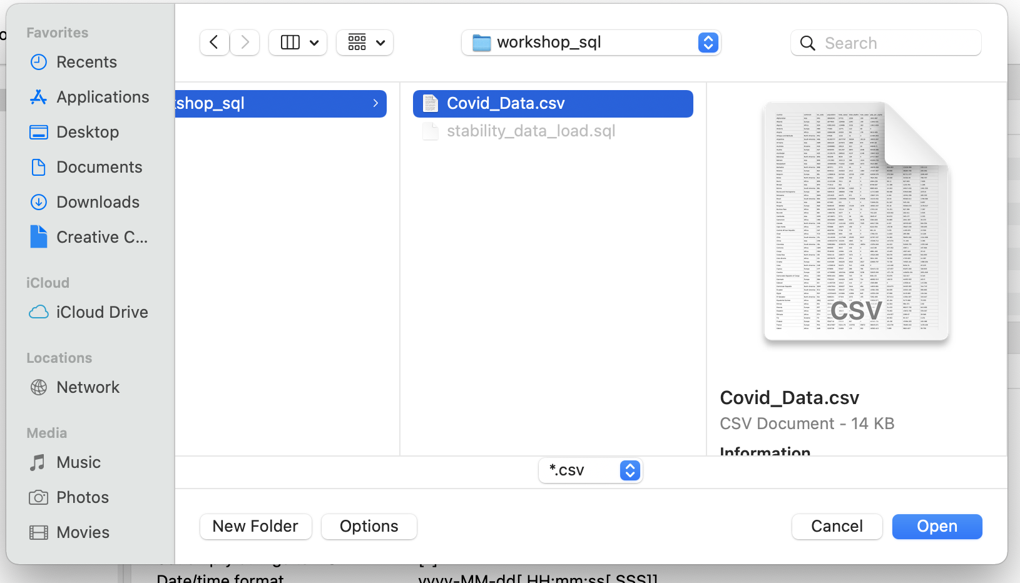
Import CSV (cont.)

Slide 19
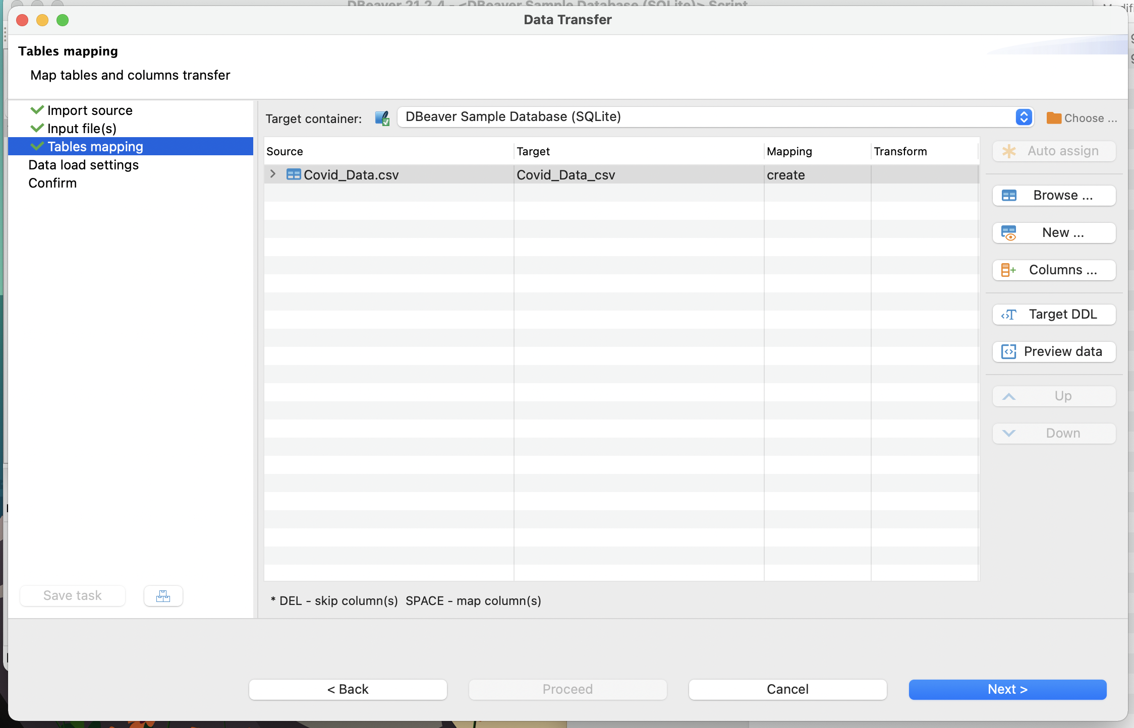
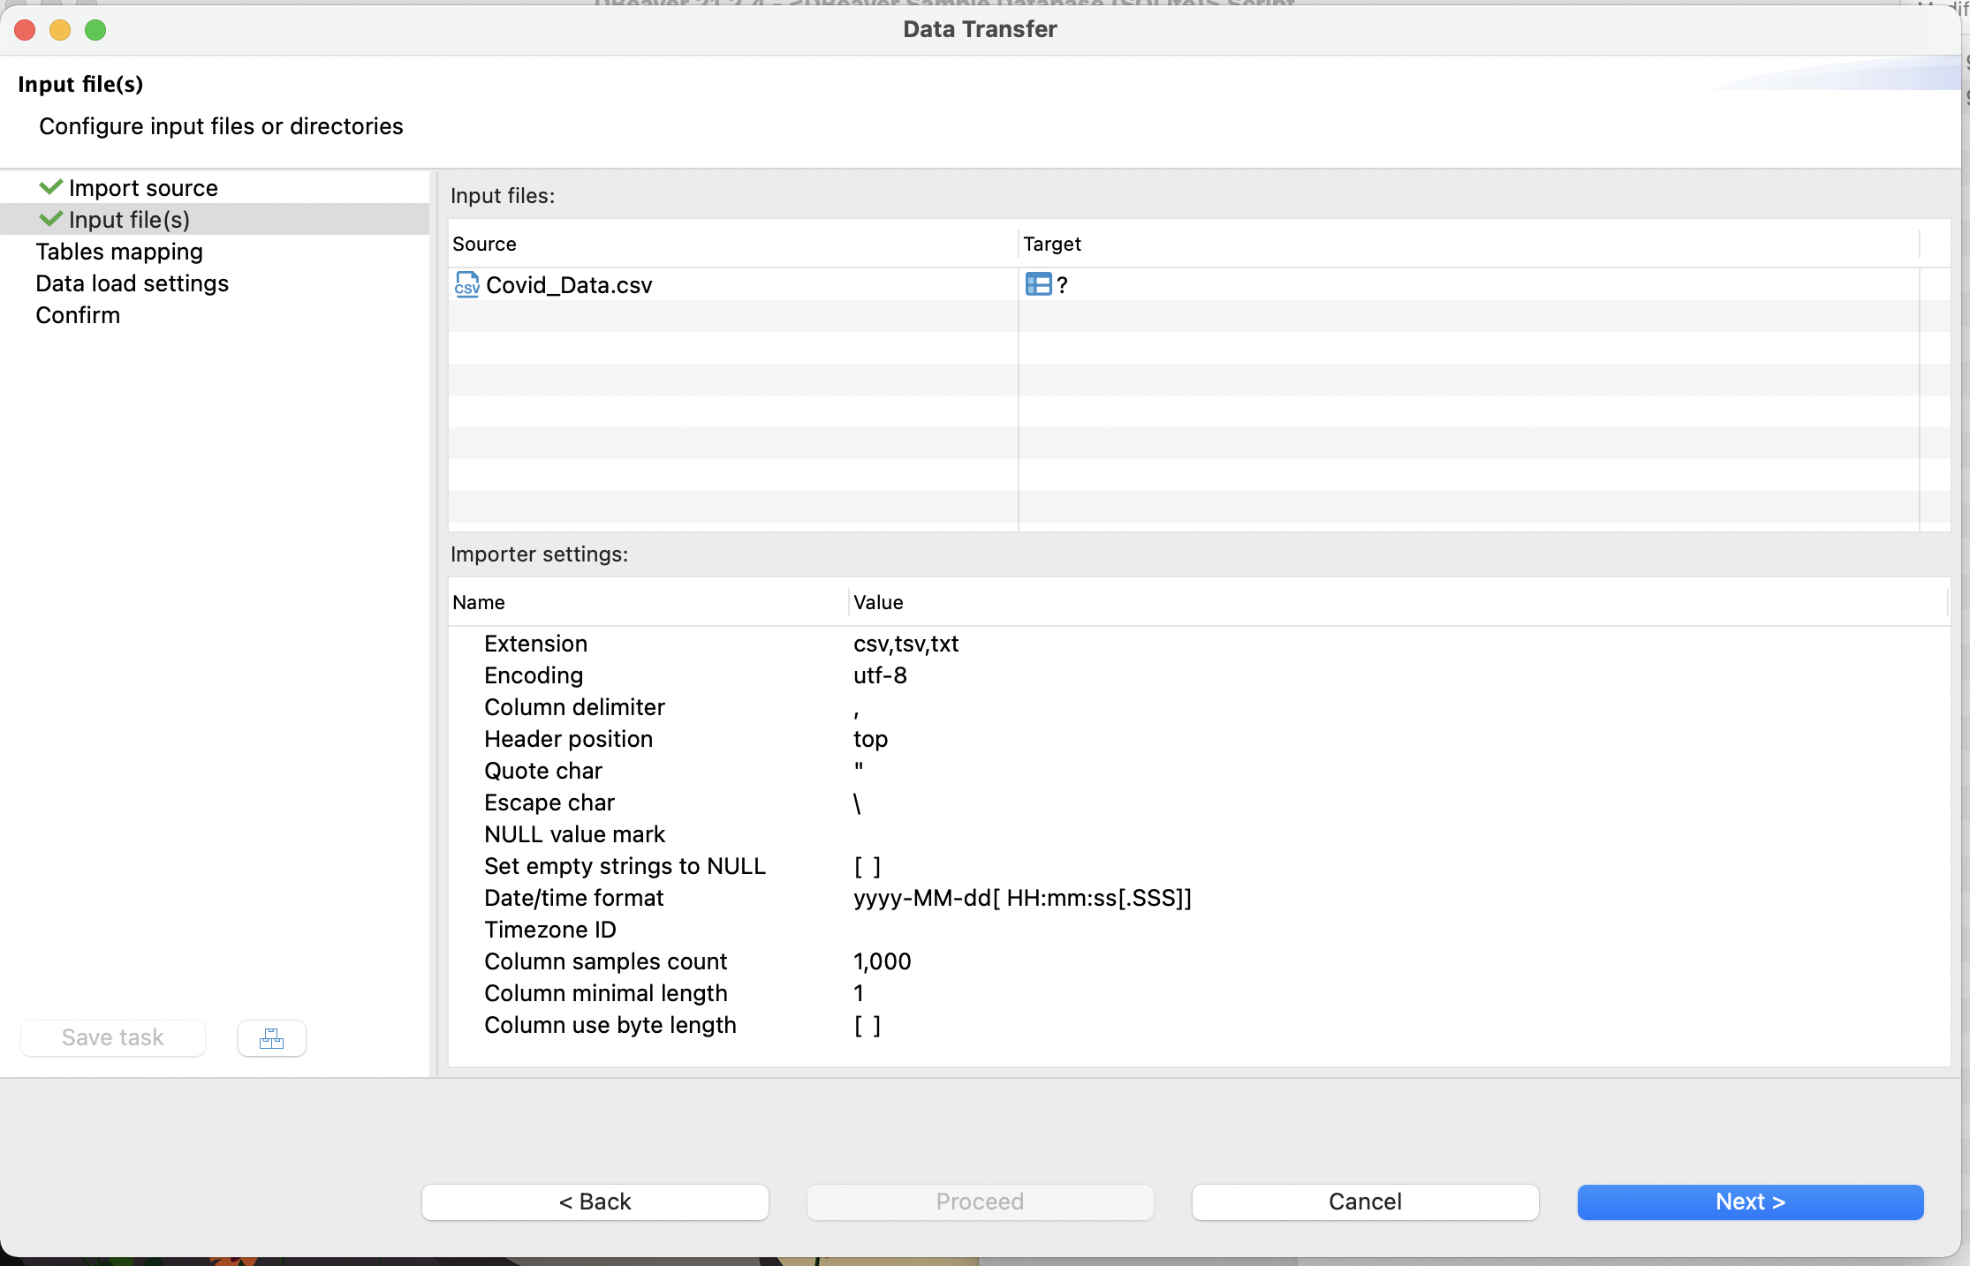
Import CSV (cont.)

Slide 20
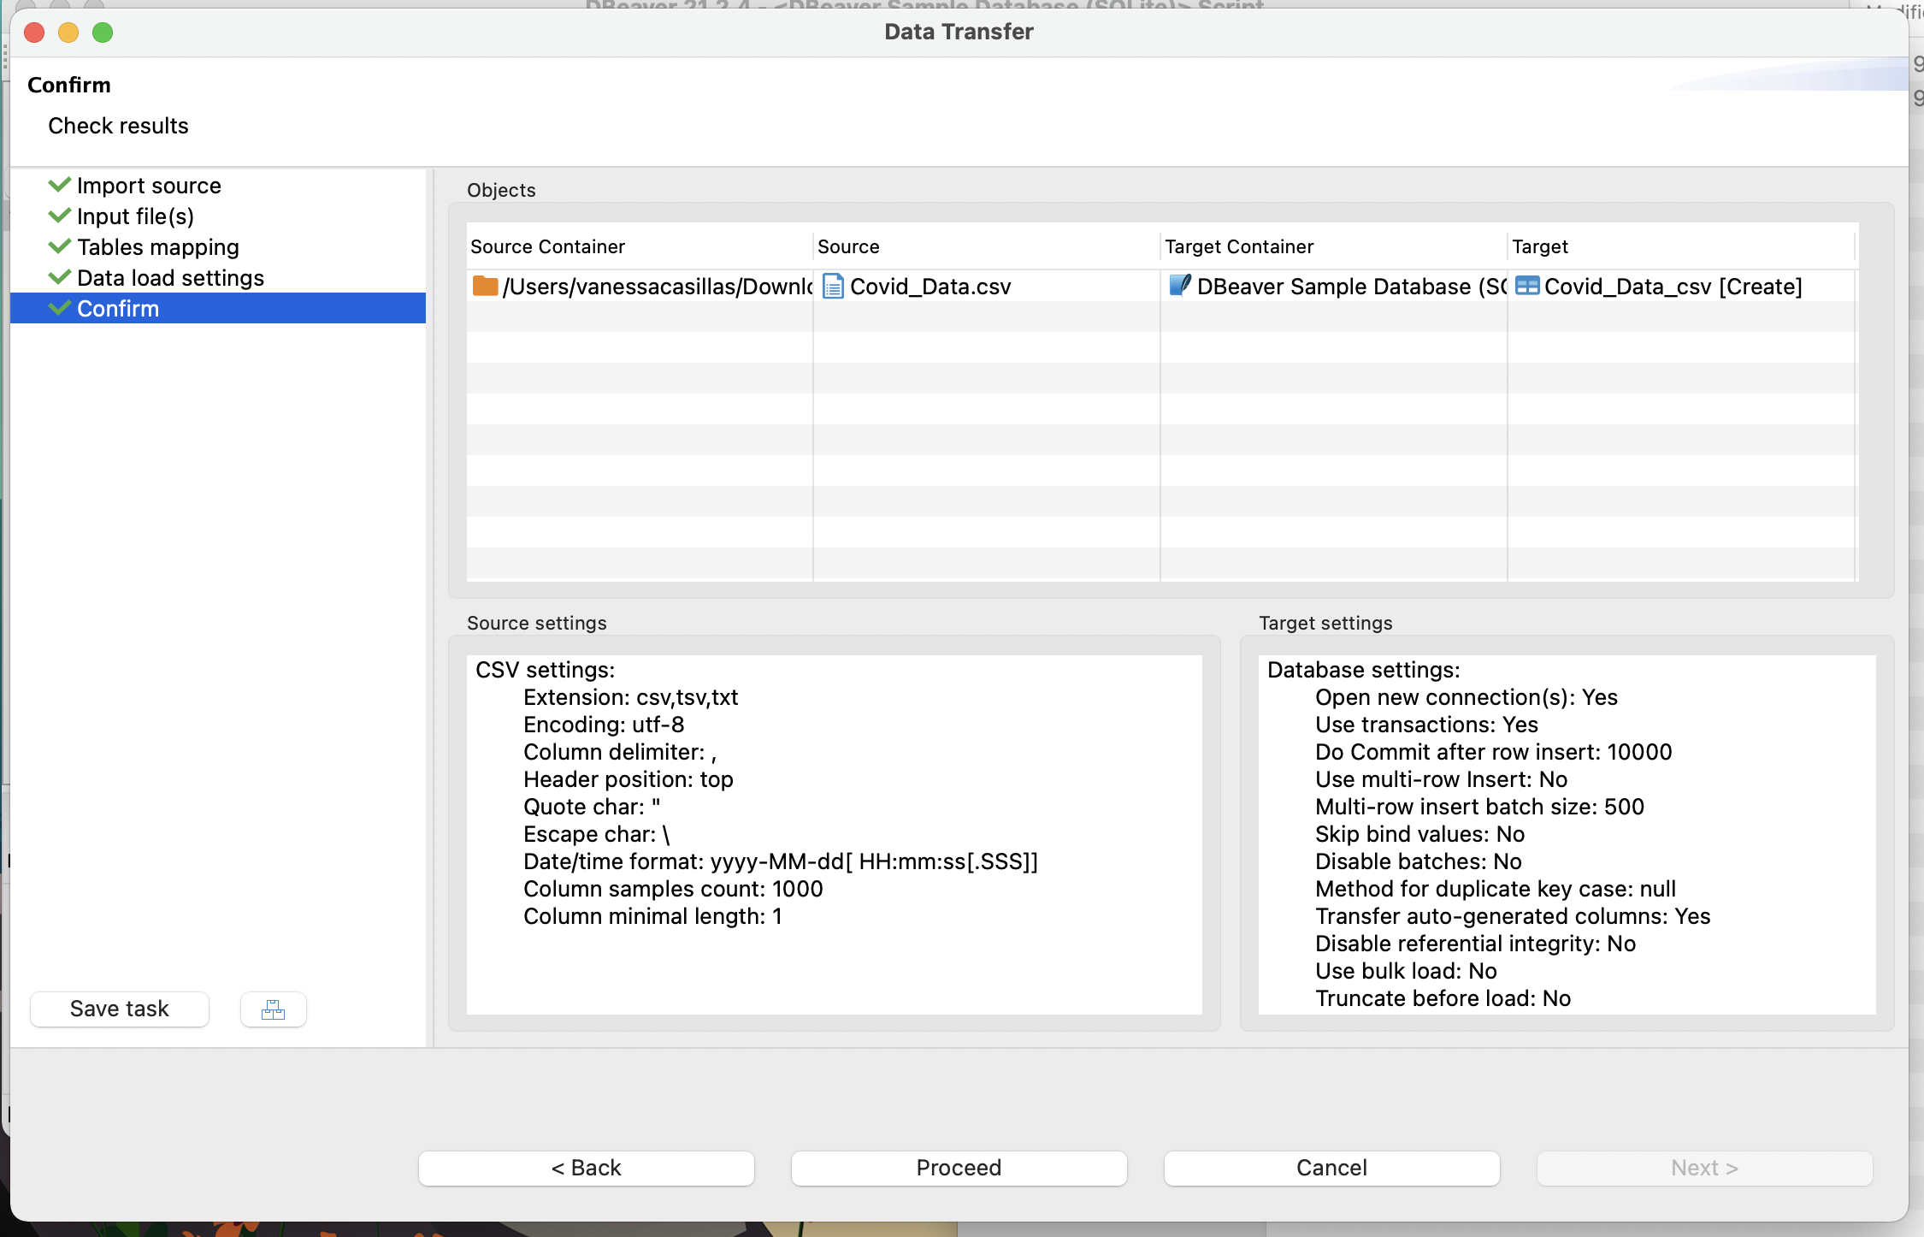
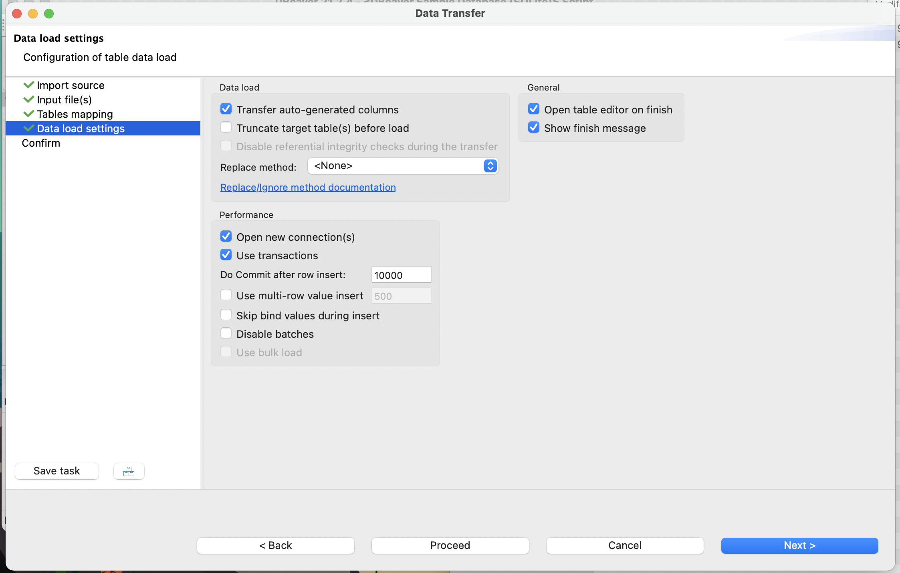
Import CSV (cont.)

Slide 21
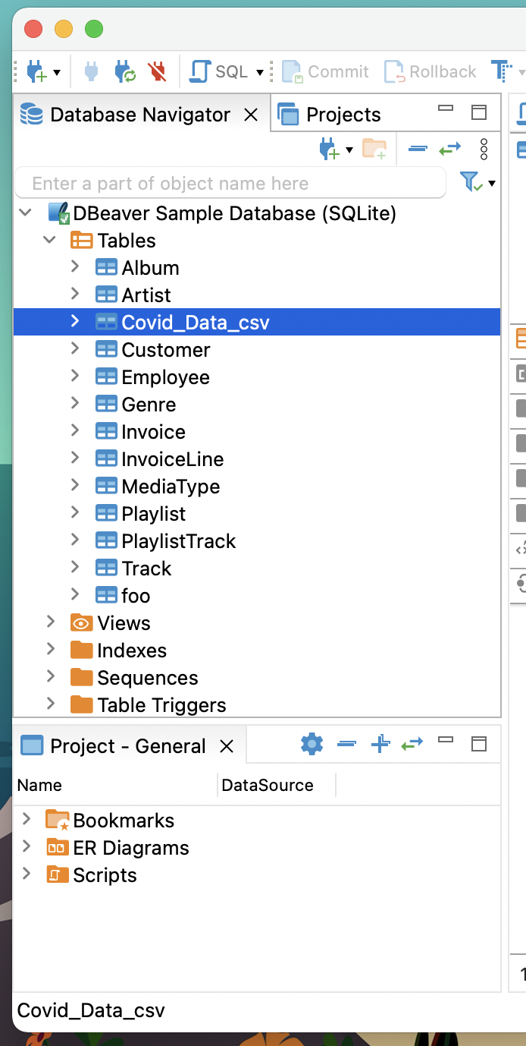
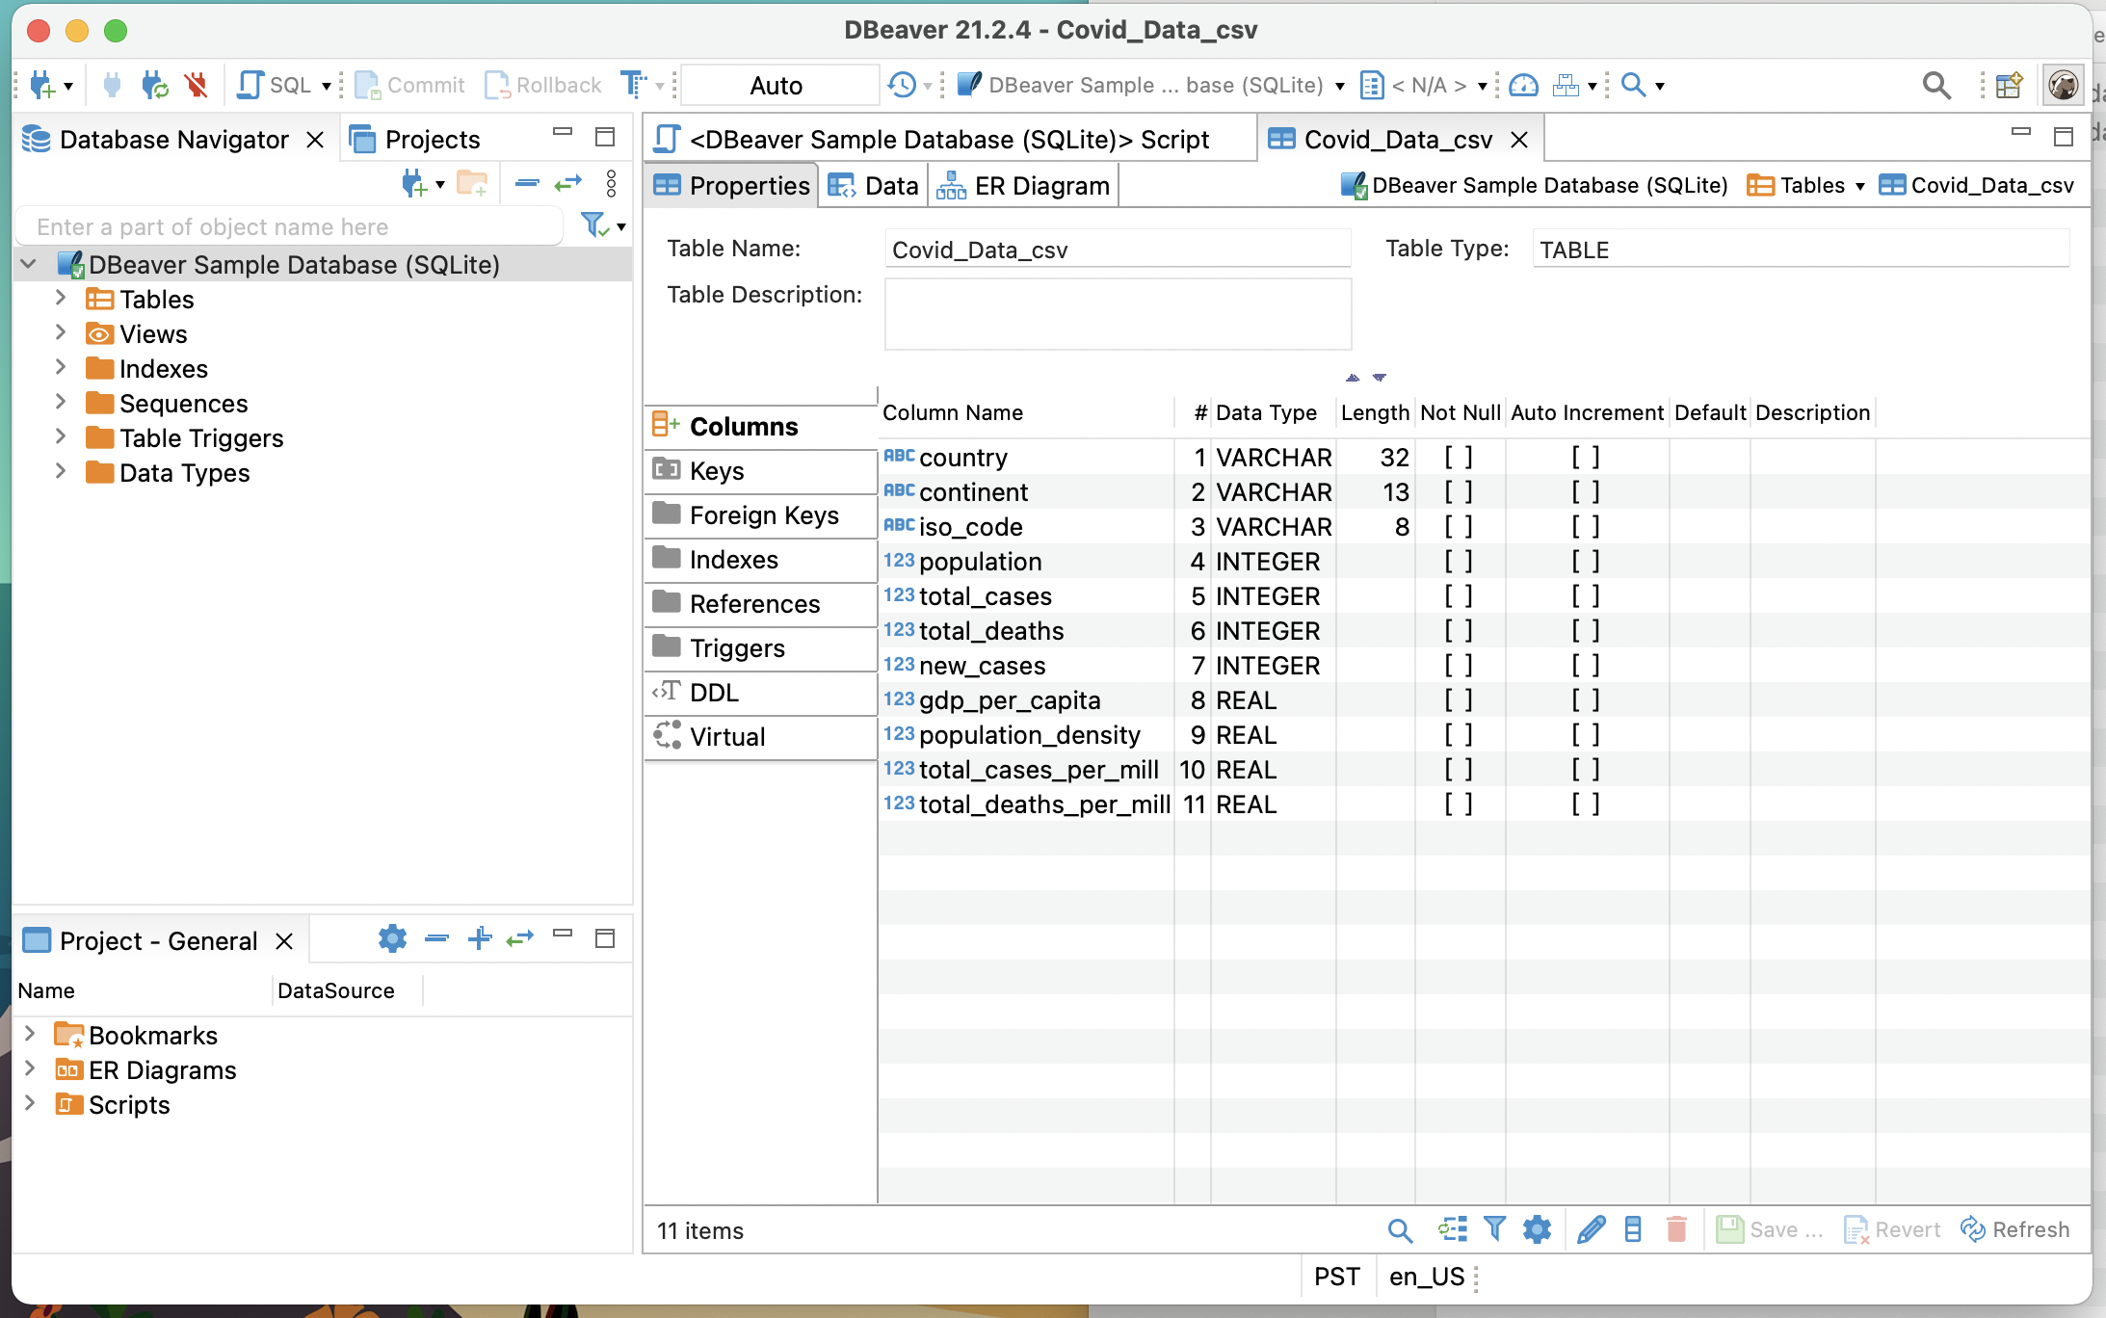
Successful Import of CSV

Slide 22
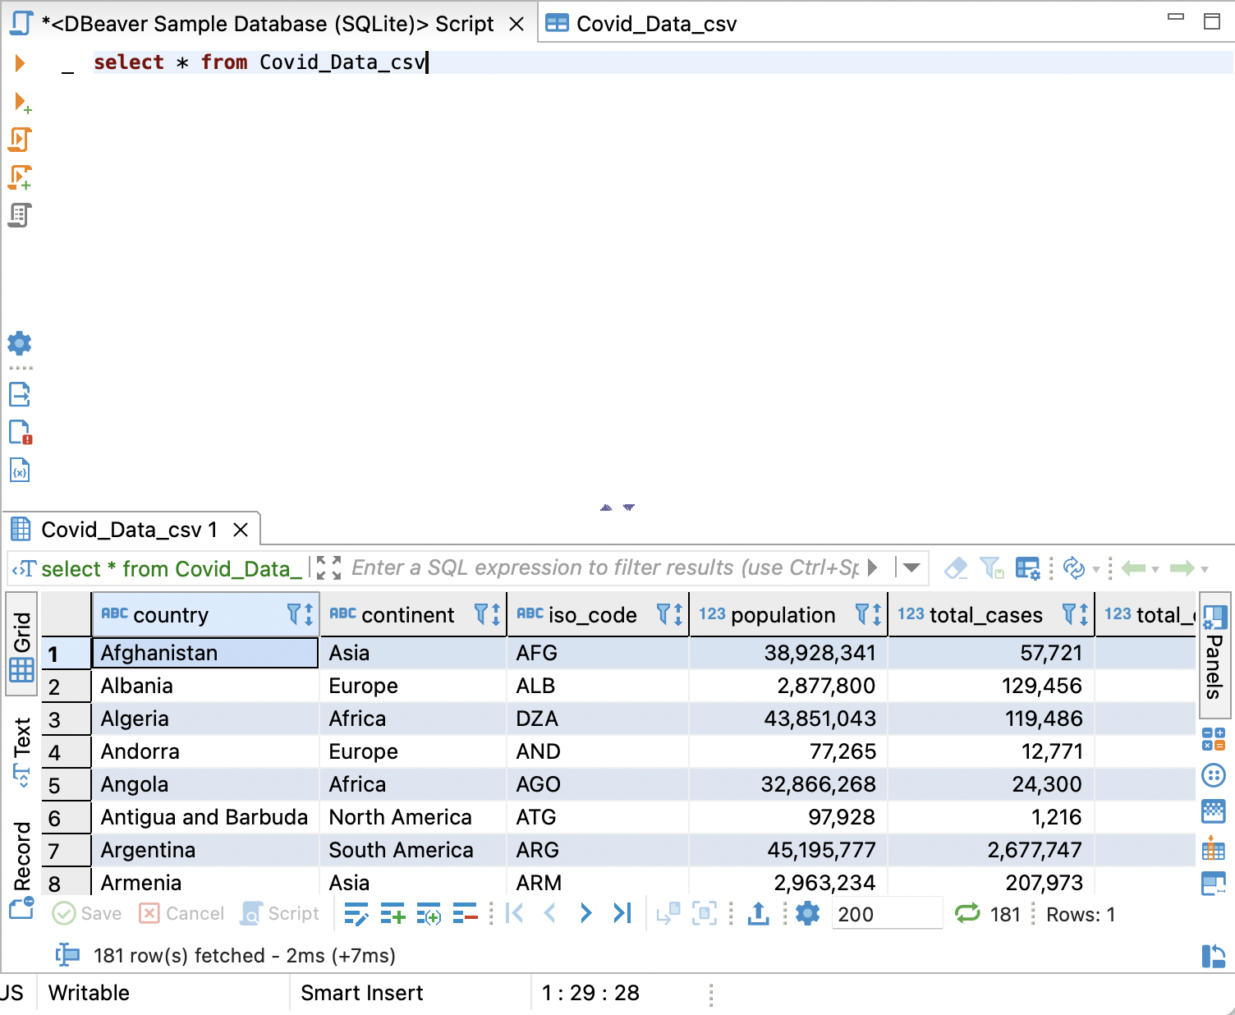
Select
select * from covid_data_csv
Will show all the data within the table due to the wildcard
How many rows?
How many attributes?
select country, population, total_cases from covid_data_csv
Will show the columns that we like to see only
Notes:
DELETE:
Removes a row (or a group of rows) from a database
SELECT:
Selects certain columns from a table. A common part of most queries

Slide 23
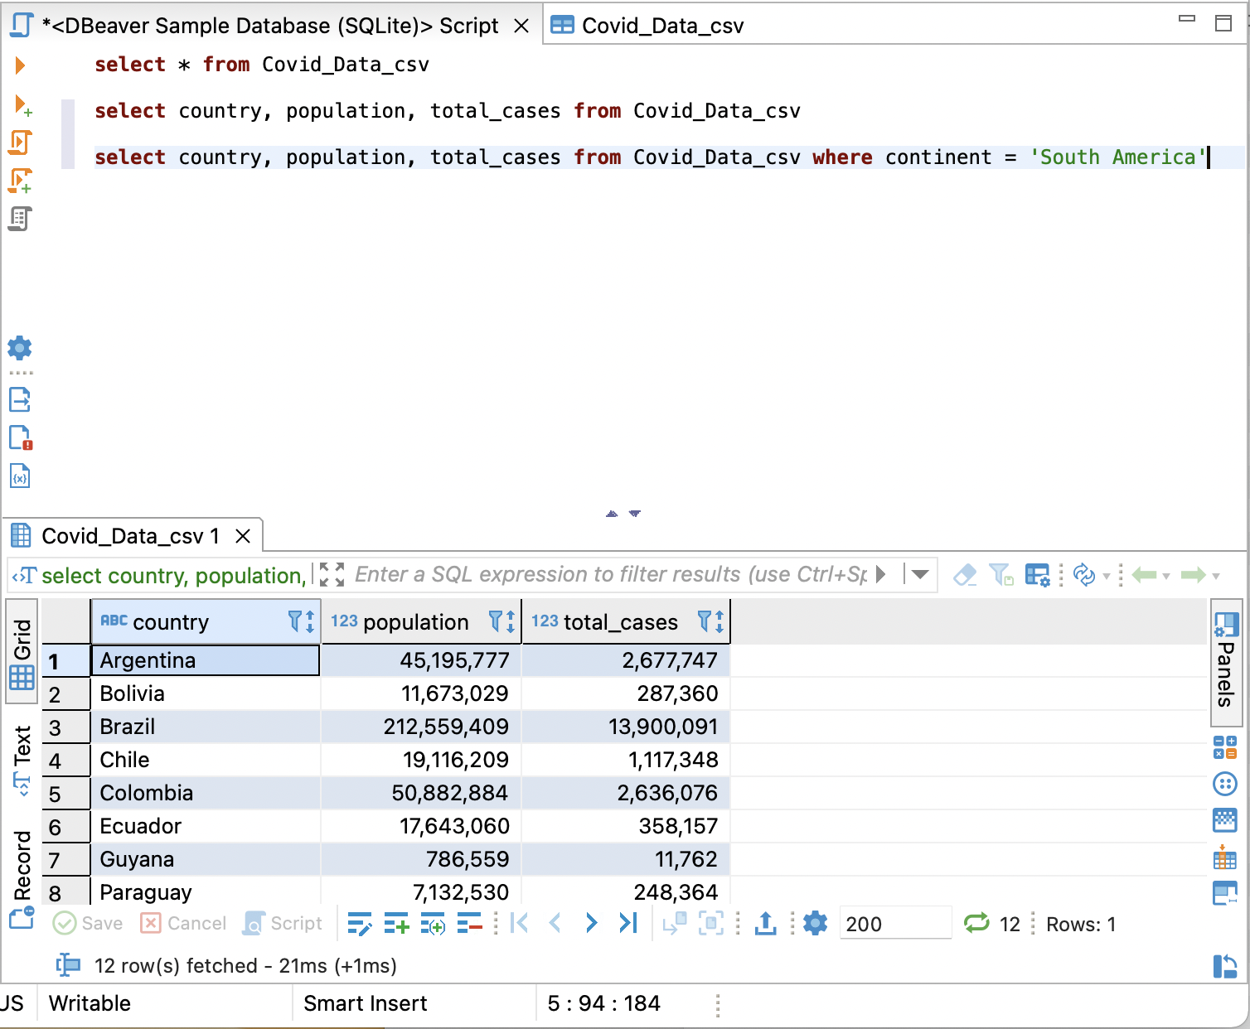
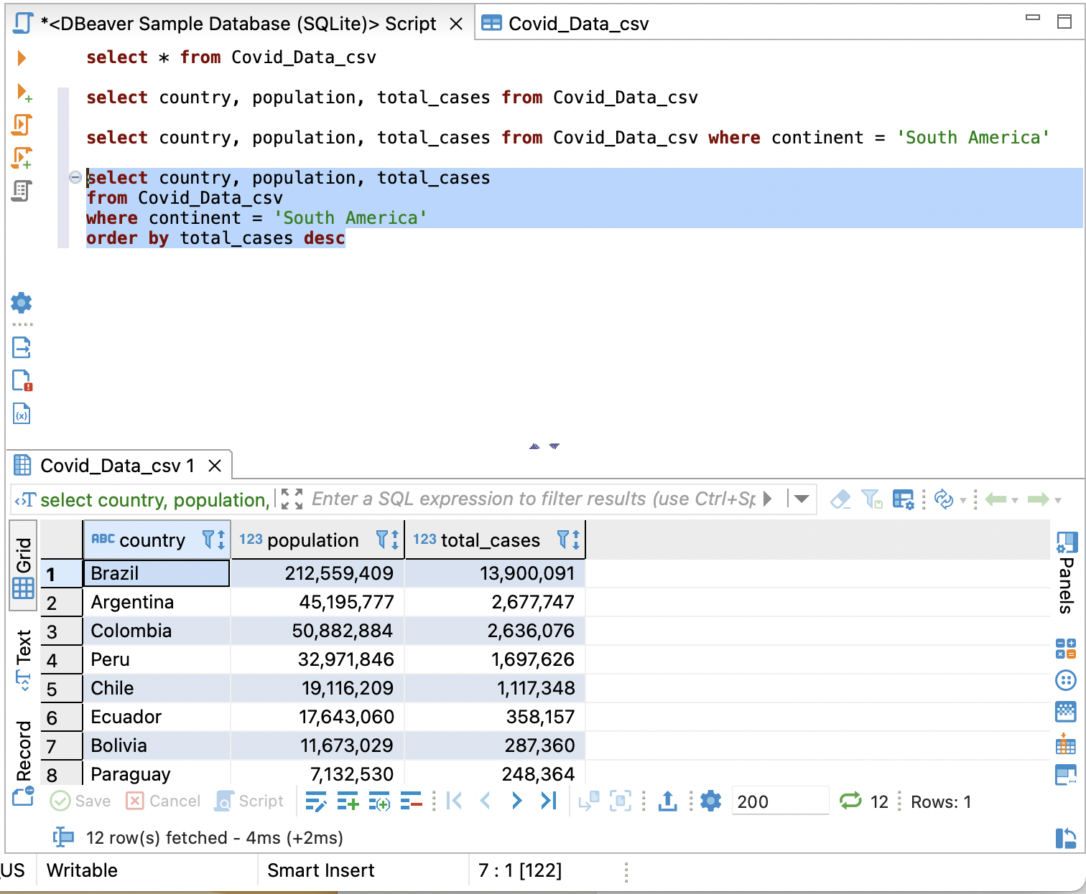
Where and Order by
select country, continent, population, total_cases from covid_data_csv where continent = ‘South America’
select country, continent, population, total_cases from covid_data_csv where continent = ‘South America’ order by total_cases desc
Default is asc

Slide 24
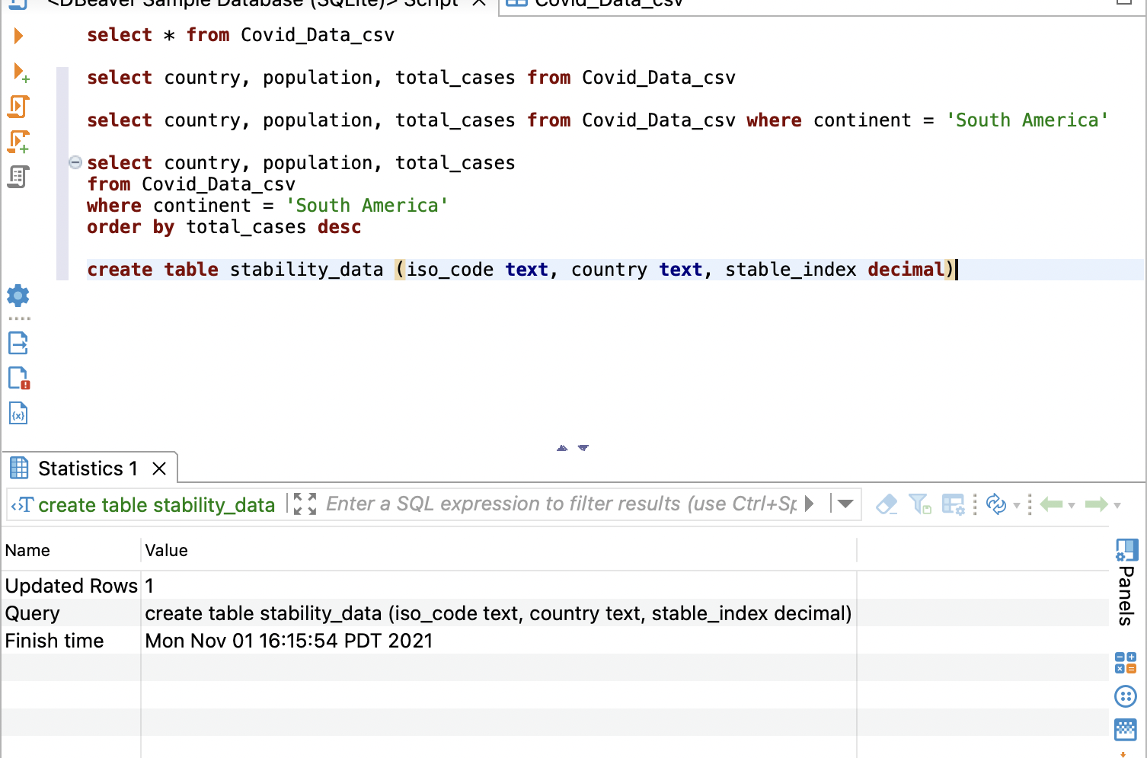
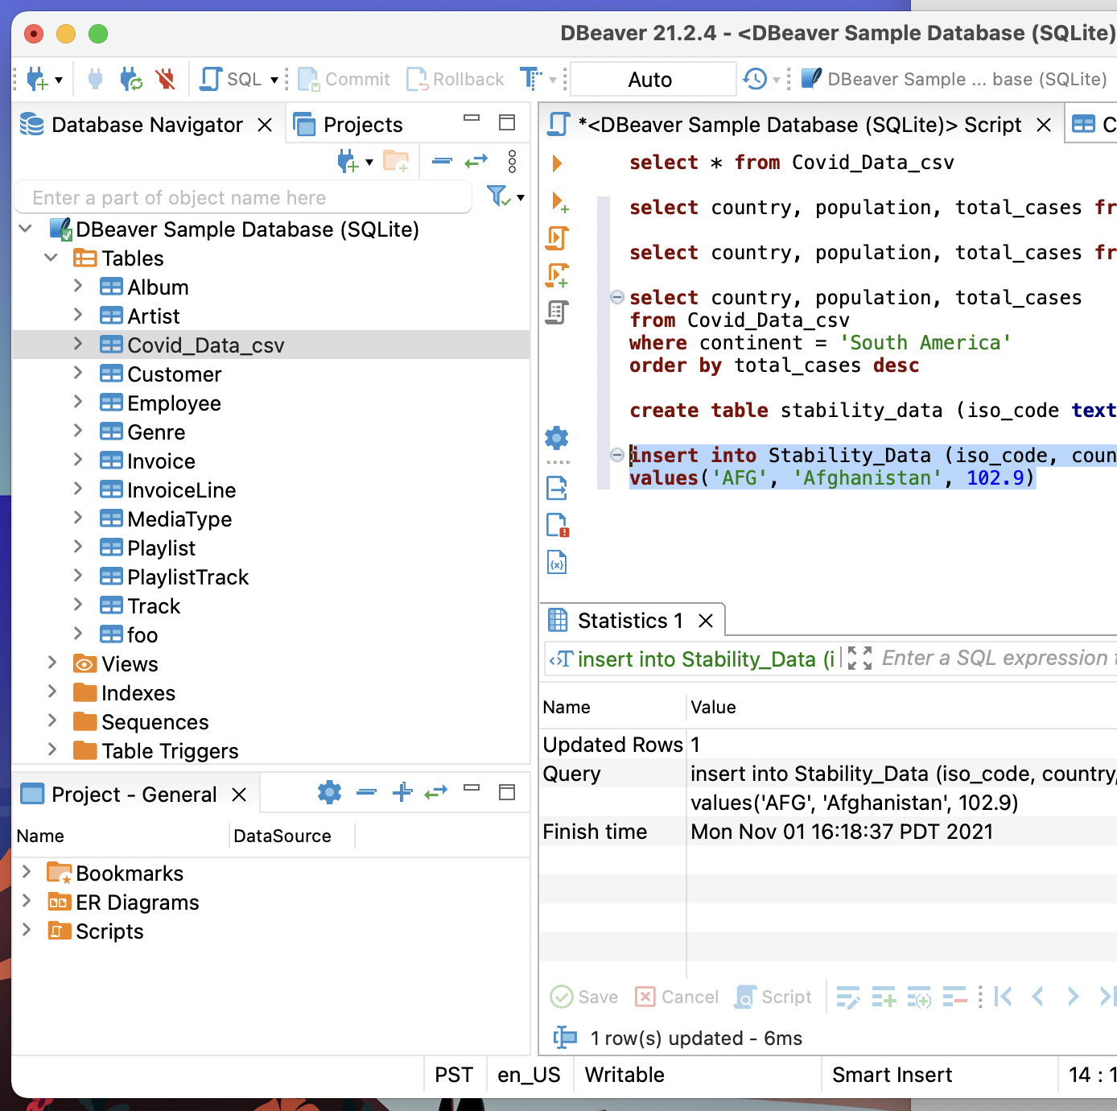
Create Table
create table stability_data (iso_code text, country text, stable_index decimal)
insert into insert into stability_Data (iso_code, country, stable_index)values('AFG', 'Afghanistan', 102.9)
select * from stability_data
Load stability_data_load.sql
select * from stability_data
Look at table data
Which column looks like a column that has the same information for covid_data?
Notes:
CREATE TABLE:
Creates a table in relational database and, depending on what database you use (e.g., MySQL), can also be used to define the table's schema
INSERT:
Inserts a row (or a set of rows) into a given table
UPDATE:
Modifies already-existing data

Slide 25
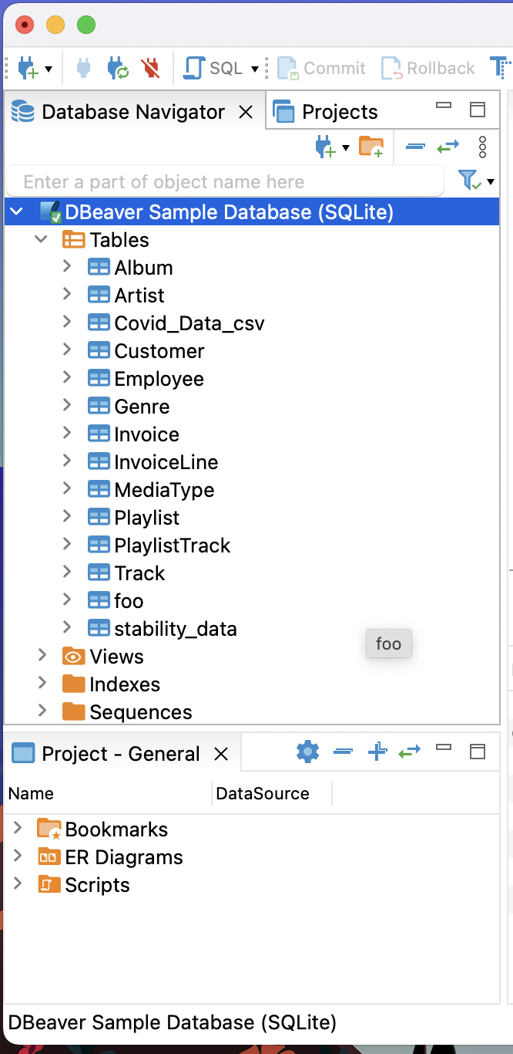
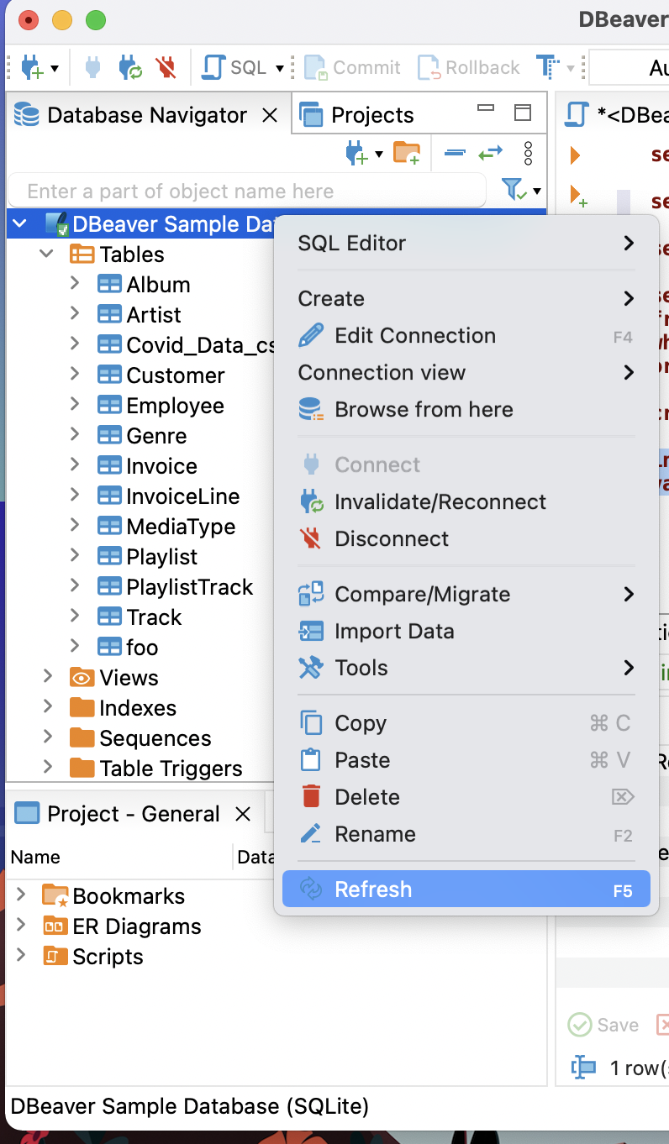
Refresh

Slide 26
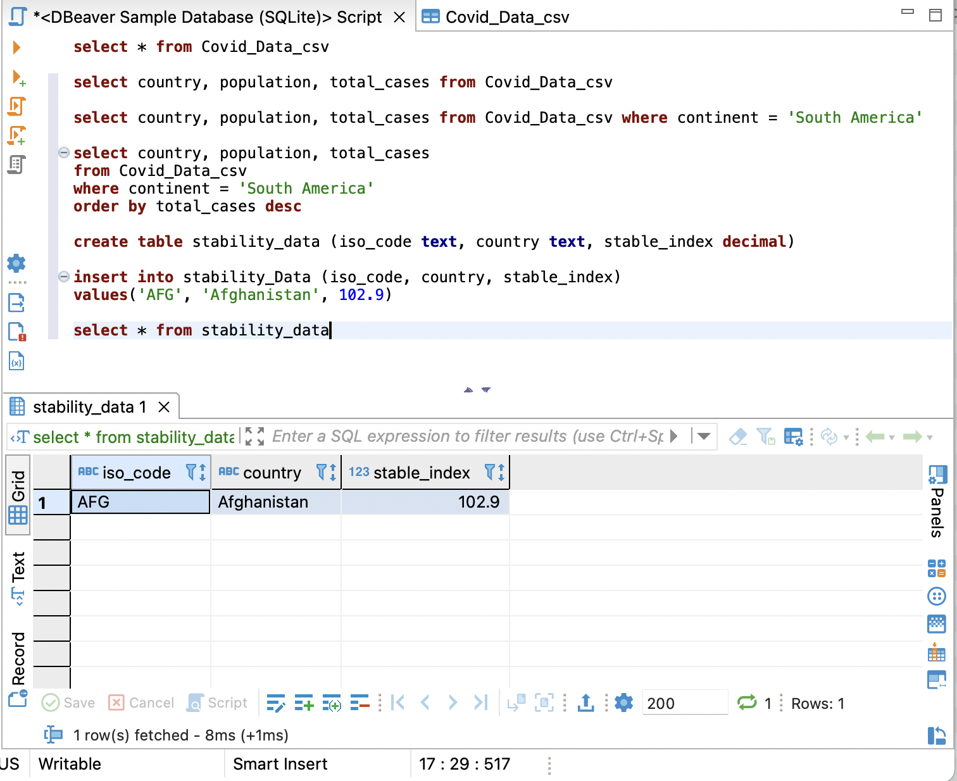
Insert data

Slide 27
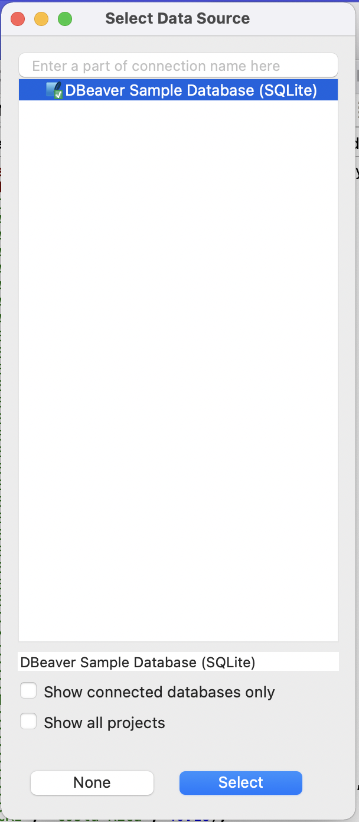
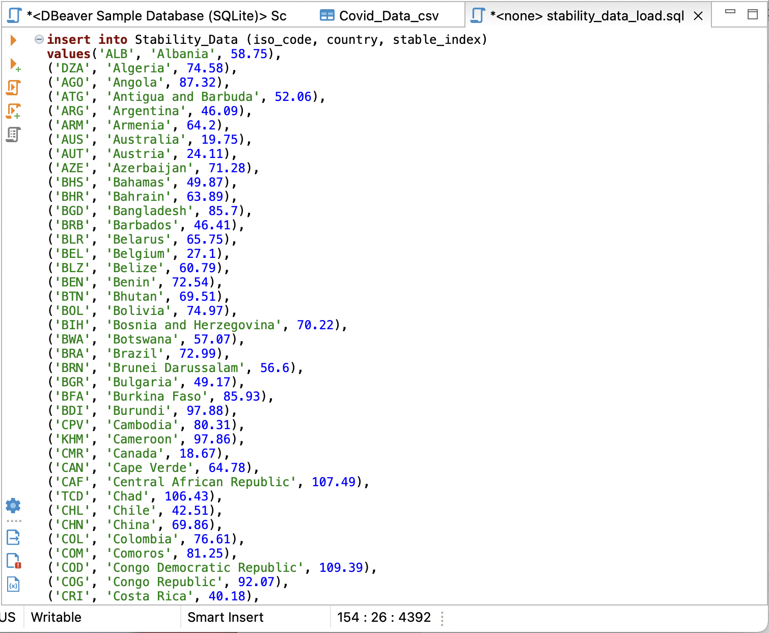
Insert data (alternative)
Click on data source
Click select

Slide 28
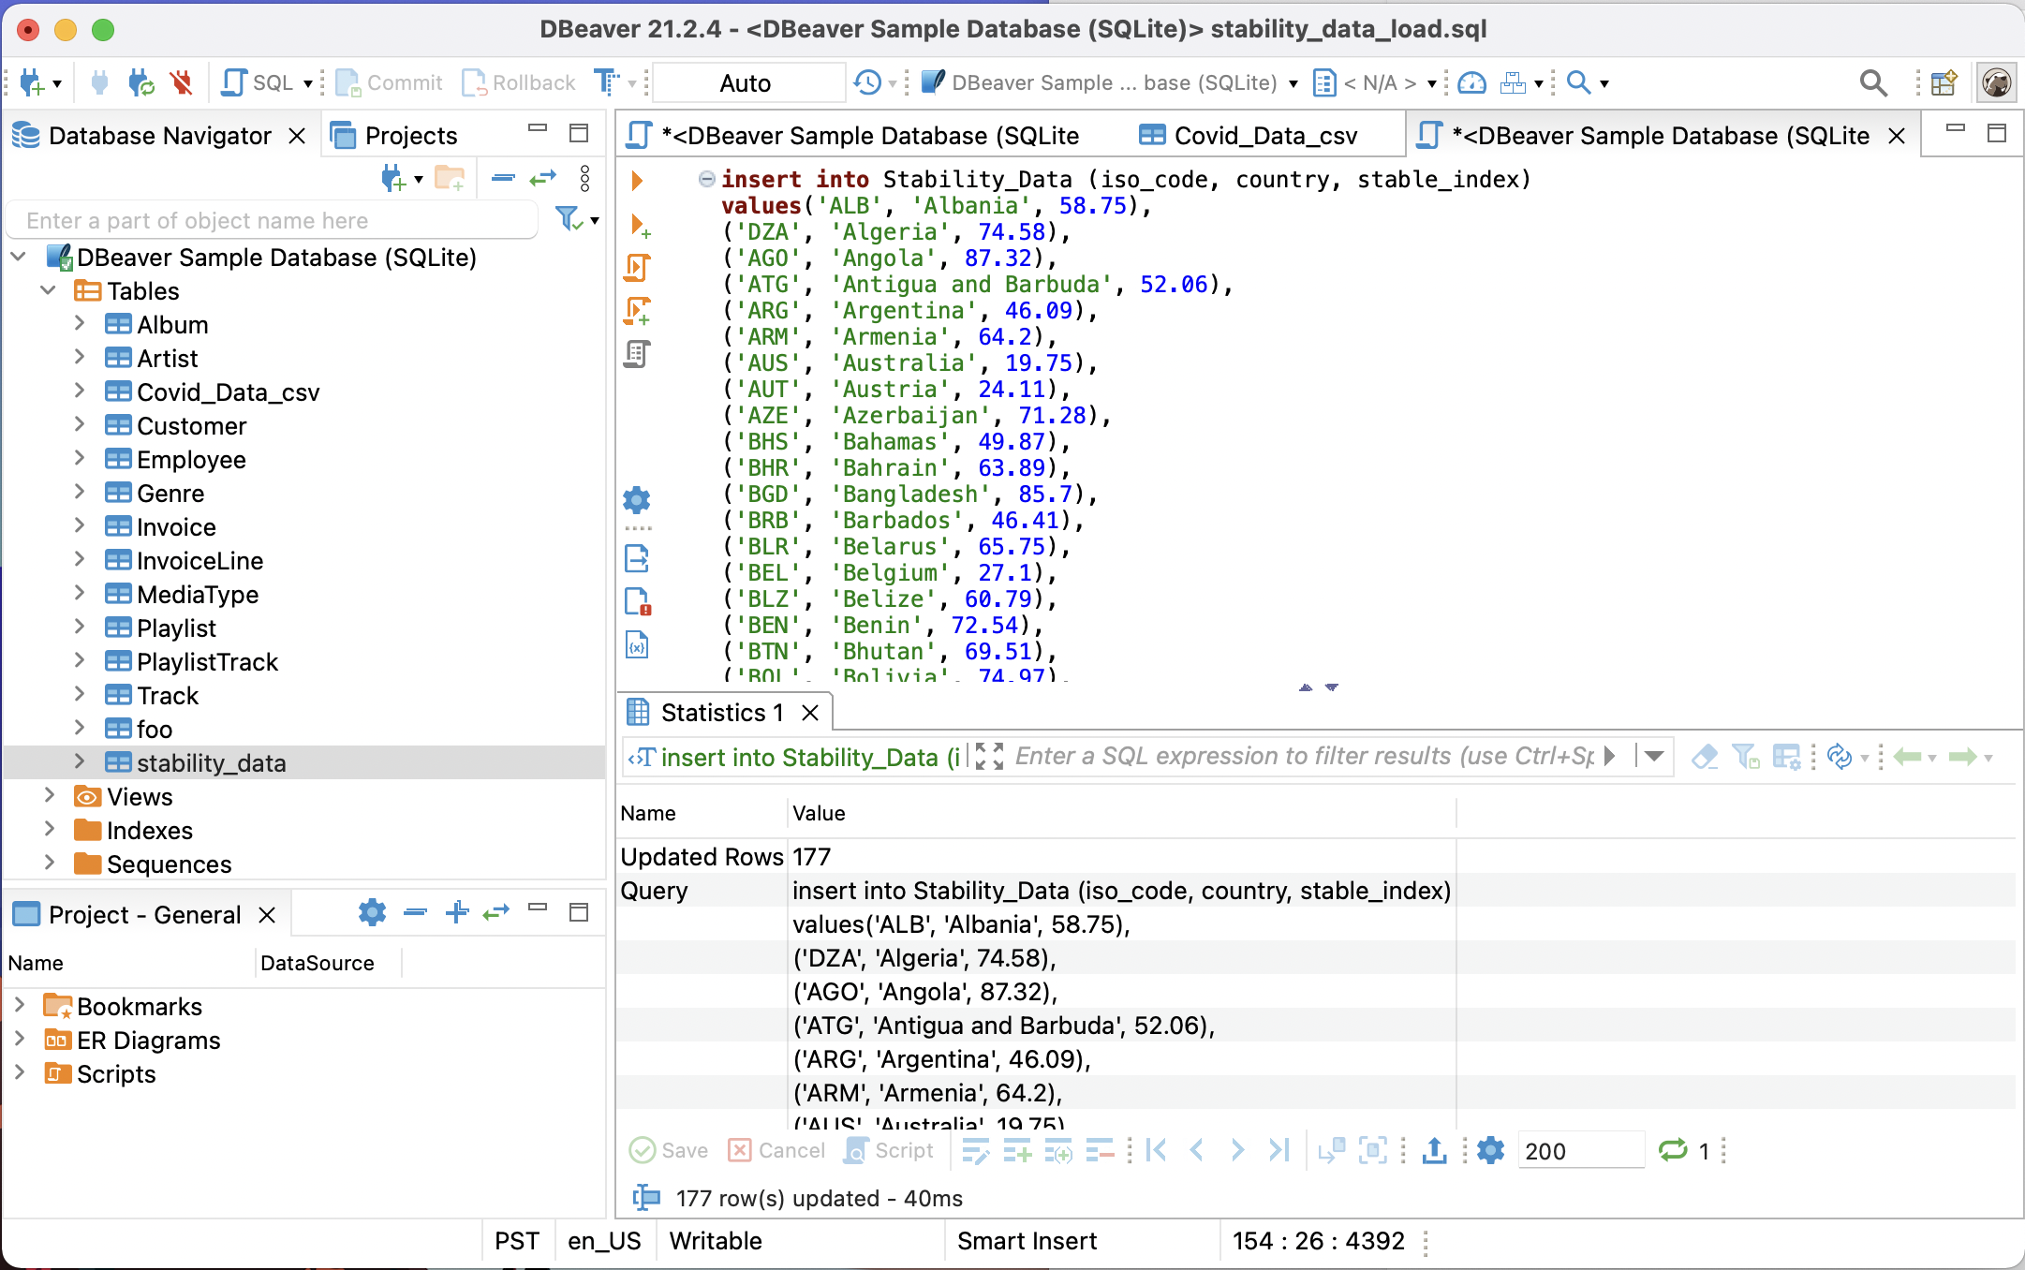
Insert data (cont.)

Slide 29
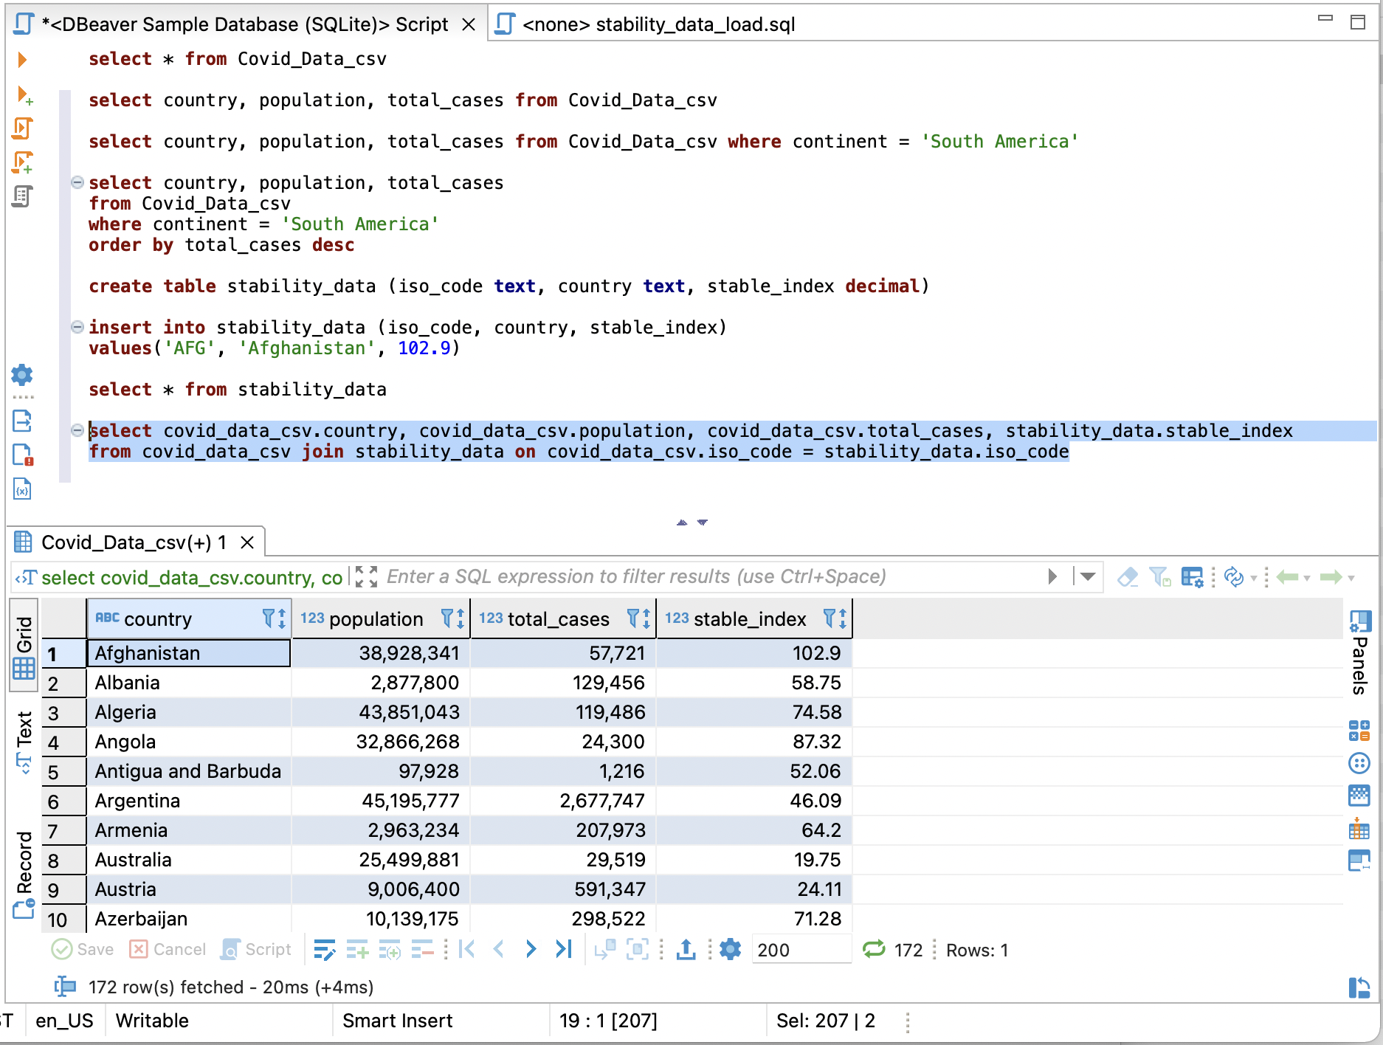
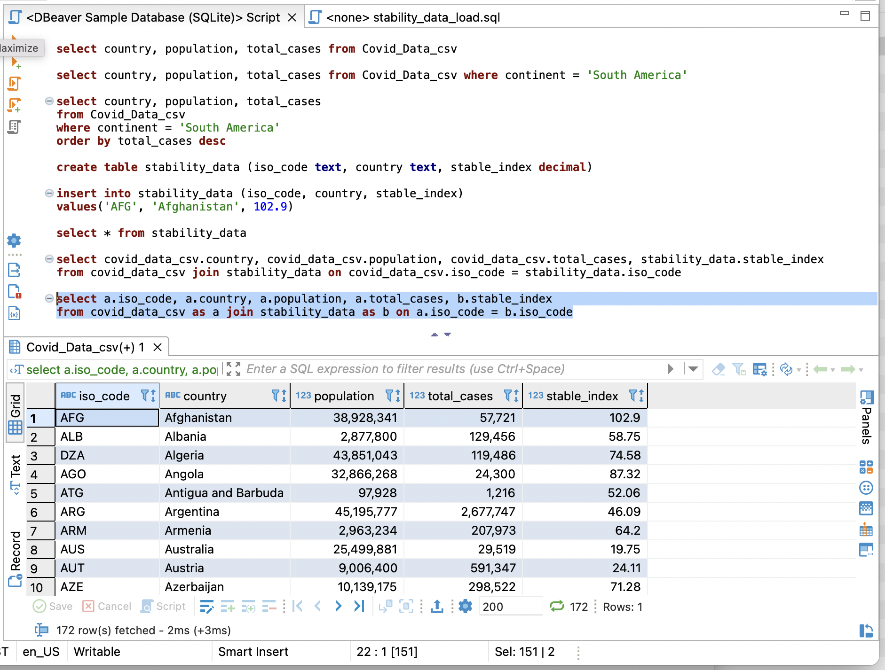
Joins and Alias
select covid_data_csv.country, covid_data_csv.population, covid_data_csv.total_cases, stability_data.stable_index from covid_data_csv join stability_data on covid_data_csv.iso_code = stability_data.iso_code
Make new table that shows the data we would like to see
select a.iso_code, a.country, a.population, a.total_cases, b.stable_index from covid_data_csv as a join stability_data as b on a.iso_code = b.iso_code
Give alias

Slide 30
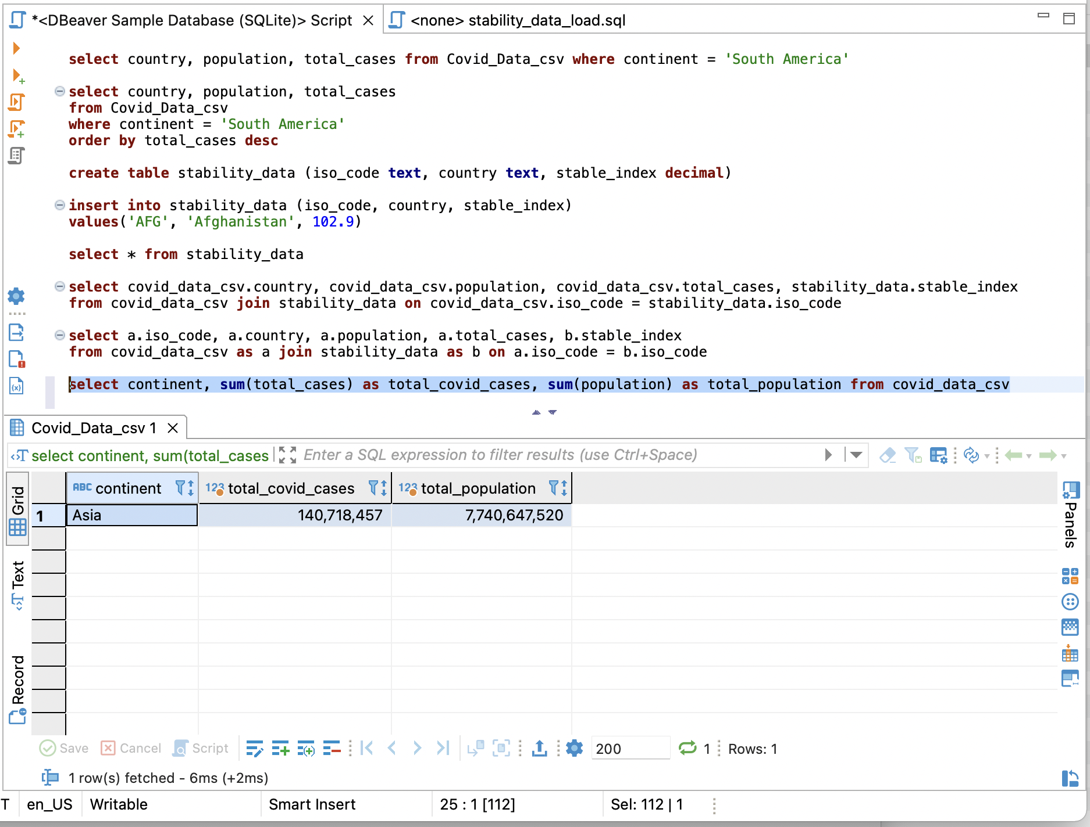
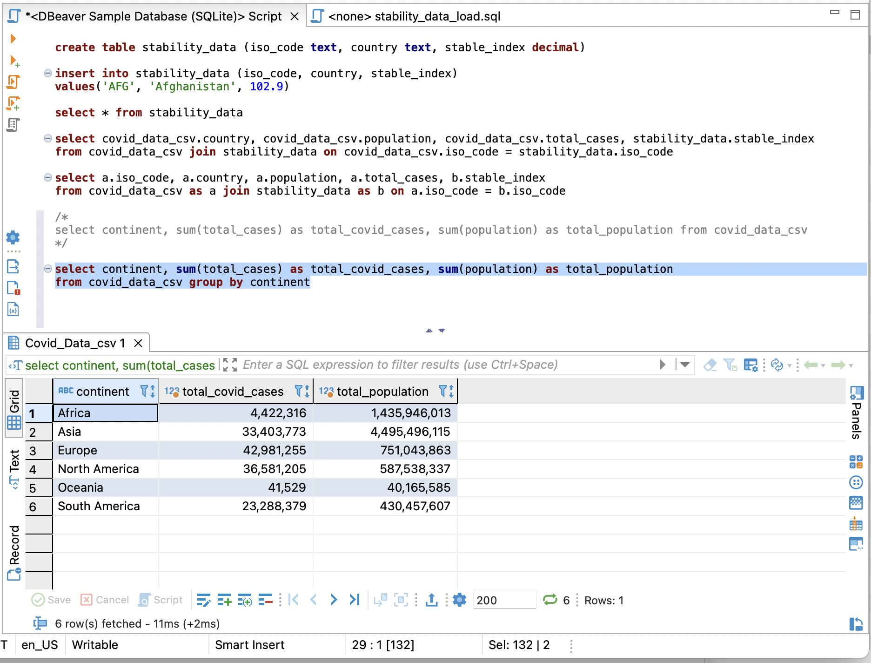
Aggregate Functions
select continent, sum(total_cases) as total_covid_cases, sum(population) as total_population from covid_data_csv
Error all just in Africa
select continent, sum(total_cases) as total_covid_cases, sum(population) as total_population from covid_data_csv group by continent
Better representation
Notes:
DISTINCT:
Returns only distinct values
UNION:
Combines results from multiple SELECT statements
JOINS:
Inner, Outer, Left, Right
GROUP BY:
Groups/aggregates rows having the contents of a specific column or a set of columns
WHERE:
Provides a condition on which to filter before any grouping is applied
HAVING:
Provides a condition on which to filter after any grouping is applied
ORDER BY:
Sorts results in ascending or descending order according to the contents of a specific column or set of columns

Slide 31
Writing Query
Select – Returns the data that was requested
From – choose a table to draw information from
Join – matches records from different tables
Where – filters data bases on request
Group By – aggregates the data
Having – filers aggregated data
Order by – sorts the data
Limit – limit the number of rows returned

Slide 32
Operation Order
From – choose a table to draw information from
Join – matches records from different tables
Where – filters data bases on request
Group By – aggregates the data
Having – filers aggregated data
Select – Returns the data that was requested
Order by – sorts the data
Limit – limit the number of rows returned

Slide 33
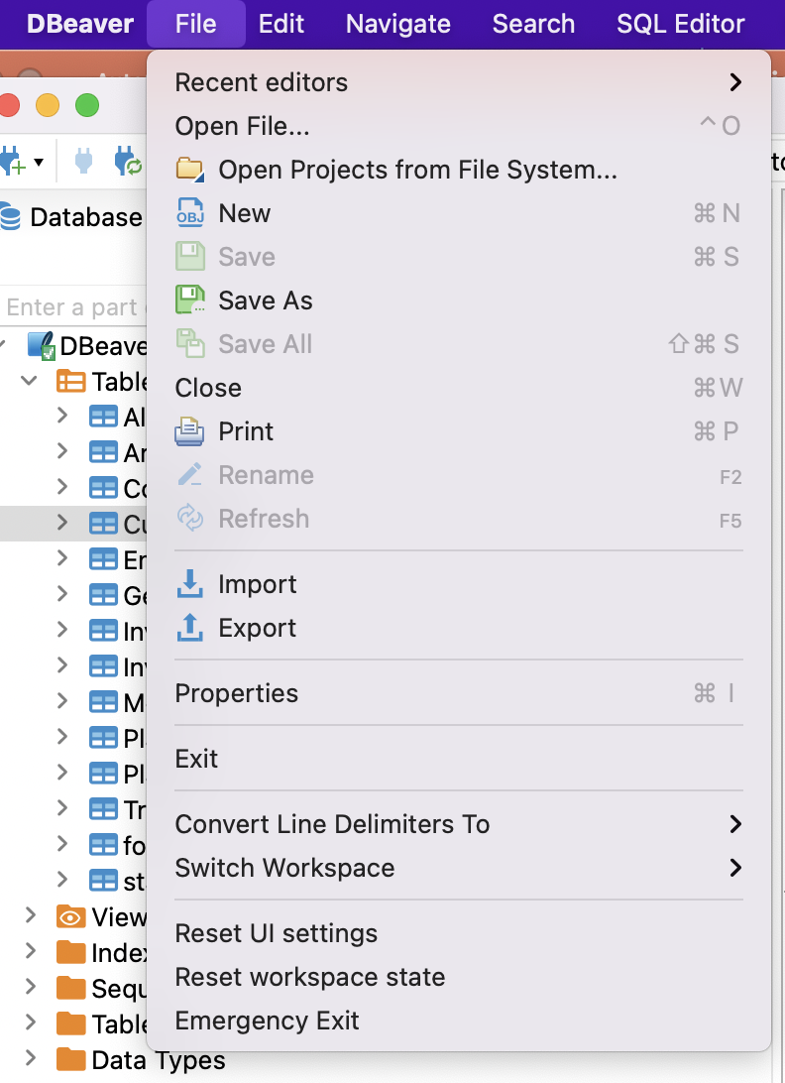
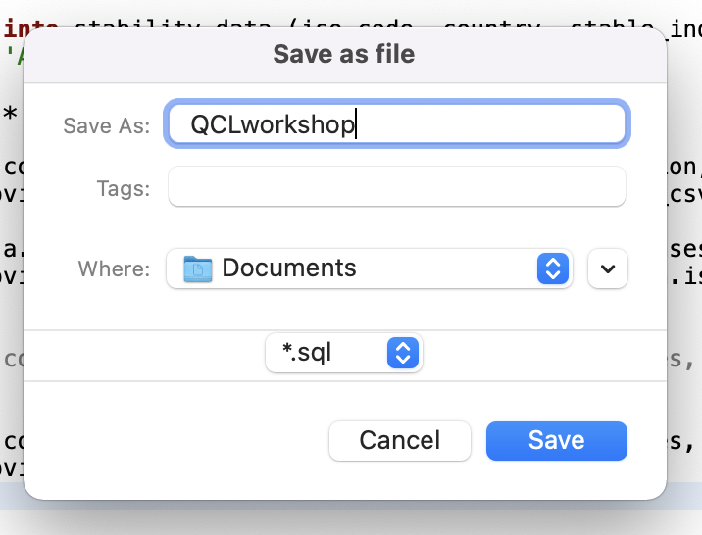
Save

Slide 34

Activity

Slide 35

Questions
From the COVID 19 Data table write queries to show the following:
What country has the highest number of total cases?
Hint: select/from/order by
What country has the smallest population density?
Hint: select/from/order by
What is the total population of the continent North America?
Hint: group by
What country has the lowest number of new cases?
Hint: group by/ order by
What country in North America has the highest number of total cases?
Hint: where

Slide 36
Answers
Let’s do it together!

Slide 37
Resources
DbeaverWiki https://github.com/dbeaver/dbeaver/wiki
W3schools -https://www.w3schools.com/sql/default.asp
CodeAcademy-https://www.w3schools.com/sql/default.asp

Slide 38
Contact info
QCL: QCL@cmc.edu
Vanessa Casillas: vanessa.casillas@claremontmckenna.edu

